Slide 1
Introduction to PL/SQL, Advanced PL/SQL
Unit -4

Slide 2
TOPIC
• SQL v/s PL/SQL
• PL/SQL Block structure
• Language construct of PL/SQL (Variable, Basic and Composite Data Type, Conditions, Looping etc.)
• %Type and %Rowtype
• Using Cursor (Implicit, Explicit)
• Exception Handling
• Creating and Using Procedure
• Package
• Trigger
• Creating Objects
• Object in Database – Table
• PL/SQL Tables, Nested Tables, Varrays

Slide 3
SQL v/s PL/SQL

Slide 4
SQL v/s PL/SQL
SQL is a Structured Query Language used to issue a single query or execute a single insert/update/delete.
PL/SQL is a procedural language used to create applications.
SQL is used to write queries, DDL and DML statements.
PL/SQL is used to write program blocks, functions, procedures, triggers and packages.

Slide 5
SQL v/s PL/SQL
SQL may be considered as the source of data for our reports, web pages and screens.
PL/SQL can be considered as the application language similar to Java or PHP.
SQL is a data oriented language used to select and manipulate sets of data.
PL/SQL is a procedural language used to create applications.

Slide 6
SQL v/s PL/SQL
SQL is executed one statement at a time.
PL/SQL is executed as a block of code.
SQL can be embedded within a PL/SQL program.
But PL/SQL can’t be embedded within a SQL statement.

Slide 7
PL/SQL BLOCK STRUCTURE

Slide 8
PL/SQL BLOCK STRUCTURE
A PL/SQL block is defined by the keywords DECLARE, BEGIN, EXCEPTION, and END.
These keywords divide the block into a declarative part, an executable part, and an exception-handling part.
The declaration section is optional and may be used to define and initialize constants and variables.
PL/SQL blocks contain three sections
Declare section
Executable section and
Exception-handling section.

Slide 9
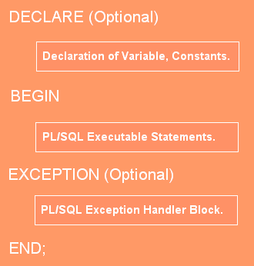

Slide 10
PL/SQL BLOCK STRUCTURE
PL/SQL block has the following structure:
DECLARE
Declaration statements
BEGIN
Executable statements
EXCETION
Exception-handling statements
END ;

Slide 11
Ex. 1 Simaple Program in pl/sql
Declare
begin
dbms_output.put_line('kamani college');
dbms_output.put_line('BCA Department');
end;

Slide 12
EX.2 Format to print massage
DECLARE
BEGIN
DBMS_OUTPUT.PUT_LINE('Start'); -- Prints with newline
DBMS_OUTPUT.PUT('This is '); -- Same line (no newline)
DBMS_OUTPUT.PUT('one line.'); -- Continues same line
DBMS_OUTPUT.NEW_LINE; -- Moves to new line
DBMS_OUTPUT.PUT_LINE('End'); -- Prints with newline
END;
/

Slide 13
🔑 Summary:
PUT_LINE → prints text + newline.
PUT → prints text only (no newline).
NEW_LINE → prints only a newline (blank line).

Slide 14
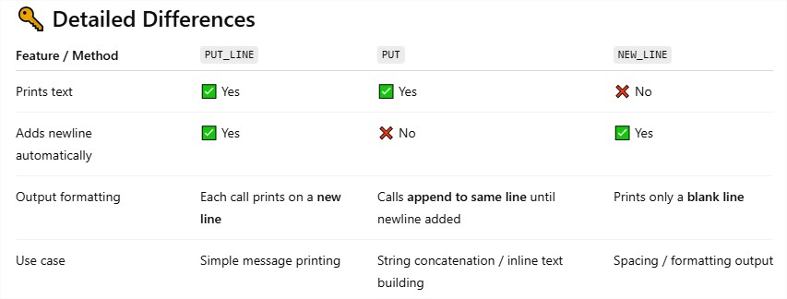

Slide 15
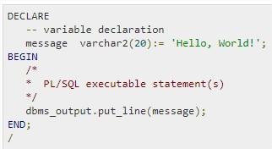
The PL/SQL Comments
The PL/SQL supports single-line and multi-line comments.
All characters available inside any comment are ignored by the PL/SQL compiler.
The PL/SQL single-line comments start with the delimiter -- (double hyphen) and multi-line comments are enclosed by /* and */.

Slide 16
Variable , basic data type, conditions loop

Slide 17
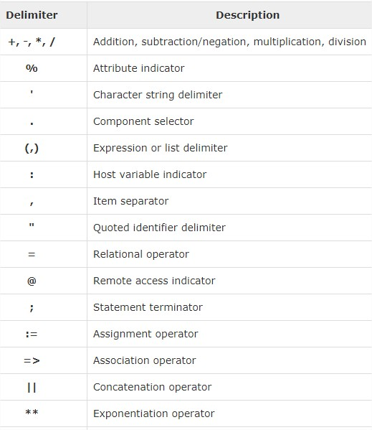
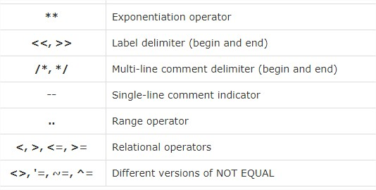
The PL/SQL Delimiters

Slide 18
The PL/SQL Identifiers
PL/SQL identifiers are constants, variables, exceptions, procedures, cursors, and reserved words.
The identifiers consist of a letter optionally followed by more letters, numerals, dollar signs, underscores, and number signs and should not exceed 30 characters.

Slide 19
Initializing Variables in PL/SQL
Whenever you declare a variable, PL/SQL assigns it a default value of NULL.
If you want to initialize a variable with a value other than the NULL value, you can do so during the declaration, using either of the following −
The DEFAULT keyword
The assignment operator (:=)

Slide 20

Ex. 1 The DEFAULT keyword
DECLARE
greetings varchar2(20) DEFAULT 'Have a Good Day ' ;
BEGIN
dbms_output.put_line(greetings);
END;

Slide 21

Ex. 2 The assignment operator (:=)
DECLARE
a integer := 10;
b integer := 20;
c integer;
f real;
BEGIN
c := a + b;
dbms_output.put_line('Value of c: ' || c);
f := 70.0/3.0;
dbms_output.put_line('Value of f: ' || f);
END;

Slide 22
Ex.3 fix values in variable
-- fix values in variable
declare
x number(3);
y number(3);
begin
x:=10;
y:=20;
dbms_output.put_line(x+y);
end;

Slide 23
Ex.4 user define values get
-- user define values get
declare
x number(3);
y number(3);
begin
dbms_output.put_line('Addition of ='||(:x + :y));
dbms_output.put_line('Subtraction of ='||(:x - :y));
dbms_output.put_line('Multiplication of ='||(:x * :y));
dbms_output.put_line('Division of ='||(:x / :y));
end;

Slide 24
Variable Scope in PL/SQL

Slide 25
Variable Scope in PL/SQL
PL/SQL allows the nesting of blocks, i.e., each program block may contain another inner block.
If a variable is declared within an inner block, it is not accessible to the outer block.
However, if a variable is declared and accessible to an outer block, it is also accessible to all nested inner blocks.
There are two types of variable scope
Local variables − Variables declared in an inner block and not accessible to outer blocks.
Global variables − Variables declared in the outer most block or a package.

Slide 26
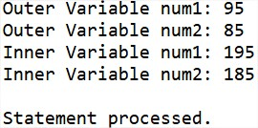
Ex.
DECLARE
-- Global variables
num1 number := 95;
num2 number := 85;
BEGIN
dbms_output.put_line('Outer Variable num1: ' || num1);
dbms_output.put_line('Outer Variable num2: ' || num2);
DECLARE
-- Local variables
num1 number := 195;
num2 number := 185;
BEGIN
dbms_output.put_line('Inner Variable num1: ' || num1);
dbms_output.put_line('Inner Variable num2: ' || num2);
END;
END;

Slide 27
PL/SQL-Constants and Literals

Slide 28
PL/SQL-Constants and Literals
A constant holds a value that once declared, does not change in the program.
A constant declaration specifies its name, data type, and value, and allocates storage for it.
The declaration can also impose the NOT NULL constraint.
Declaring a Constant
A constant is declared using the CONSTANT keyword.

Slide 29

Ex.-1 PL/SQL-Constants
DECLARE
college_name constant varchar2(20) := 'SY BCA';
BEGIN
dbms_output.put_line('I study in '|| college_name);
END;

Slide 30
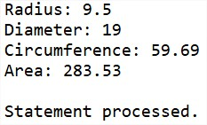
EX.-2 PL/SQL-Constants
DECLARE
-- constant declaration
pi constant number := 3.141592654;
-- other declarations
radius number(5,2);
dia number(5,2);
circumference number(7, 2);
area number (10, 2);
BEGIN
-- processing
radius := 9.5;
dia := radius * 2;
circumference := 2.0 * pi * radius;
area := pi * radius * radius;
-- output
dbms_output.put_line('Radius: ' || radius);
dbms_output.put_line('Diameter: ' || dia);
dbms_output.put_line('Circumference: ' || circumference);
dbms_output.put_line('Area: ' || area);
END;

Slide 31
The PL/SQL Literals

Slide 32
The PL/SQL Literals
A literal is an explicit numeric, character, string, or Boolean value not represented by an identifier.
For example, TRUE, 786, NULL, 'tutorialspoint' are all literals of type Boolean, number, or string.
PL/SQL,literals are case-sensitive.
PL/SQL supports the following kinds of literals −
Numeric Literals
Character Literals
String Literals
BOOLEAN Literals
Date and Time Literals

Slide 33
Ex.
DECLARE
message varchar2(30):= 'That''s tutorialspoint.com!';
str varchar2(30):= 'Welcome to Studytonight.com';
BEGIN
dbms_output.put_line(message);
dbms_output.put_line(str);
END;

Slide 34
PL/SQL-Operators

Slide 35
PL/SQL-Operators
An operator is a symbol that tells the compiler to perform specific mathematical or logical manipulation.
PL/SQL language is rich in built-in operators and provides the following types of operators −
Arithmetic operators- Addition, Subtraction, Multiplication, Division
Relational operators - Less then, Greater Than, etc.
Comparison operators- Like ,Between, In, IsNull
Logical operators- AND, OR, NOT
String operators-

Slide 36
Ex. Arithmetic operation
-- Arithmetic operation user define values get
declare
x number(3);
y number(3);
begin
dbms_output.put_line('Addition of ='||(:x + :y));
dbms_output.put_line('Subtraction of ='||(:x - :y));
dbms_output.put_line('Multiplication of ='||(:x * :y));
dbms_output.put_line('Division of ='||(:x / :y));
end;

Slide 37
PL/SQL Tables

Slide 38
PL/SQL WITH TABLE
create table emp(id number (3),name varchar2(10), salary number(10));
insert into emp values(1,'Hetansh',4000)
select *from emp
alter table emp ADD (sal_update number(10))
EX.
declare
X number(3):=2;
begin
INSERT into emp values(2,'Sagar',3000,'');
UPDATE emp set sal_update = salary * X where id=1;
--DELETE from emp where id=1;
END;

Slide 39
PL/SQL basic Data Types

Slide 40
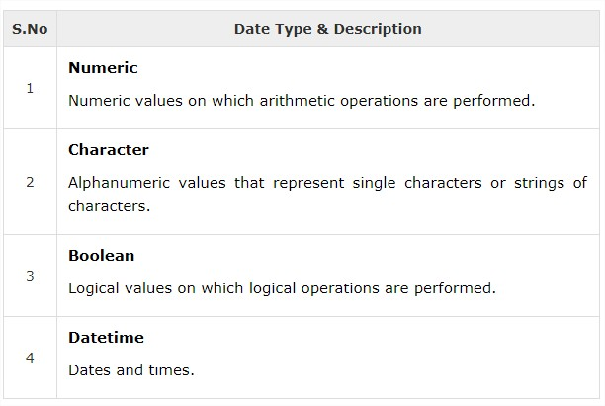
PL/SQL basic Data Types

Slide 41
Control structure

Slide 42
Three type of control structure
[1]Conditional Control
1) IF…THEN…END IF
2) IF…THEN..ELSE…END IF
3) IF…THEN…ELSIF…END IF
4) CASE…ENDCASE
5) Nested IF-THEN-ELSE
[2] Iterative Control /Looping structure
[1]Basic LOOP
[2]FOR..LOOP
[3]WHILE FOR…LOOP
[3]Sequential Control
[1]GOTO Statement

Slide 43
Conditional control
PL/SQL allows the use of an IF statement to control the execution of a block of code.
PL/SQL has four conditional or selection statement available for decision making:
1) IF…THEN…END IF
2) IF…THEN..ELSE…END IF
3) IF…THEN…ELSIF…END IF
4) CASE…ENDCASE

Slide 44
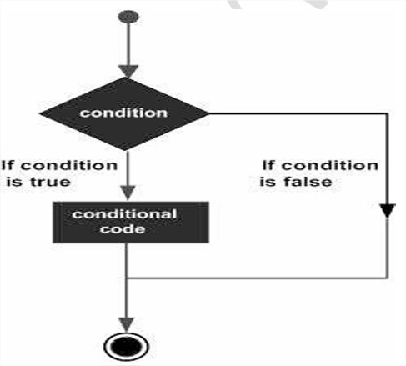
1) IF…THEN…END IF
A simple IF statement performs action statement if the result of the condition is TRUE.
If the condition is FALSE no action is performed , and the program continues with the next statement in the block.
Syntax:
If <condition>THEN
<action>
END IF

Slide 45

EXAMPLE :
DECLARE
a number(2) := 10;
BEGIN
a:= 10;
-- check the boolean condition using if statement
IF( a < 20 ) THEN
-- if condition is true then print the following
dbms_output.put_line('a is less than 20 ' );
END IF;
dbms_output.put_line('value of a is : ' || a);
END;
/

Slide 46
2) IF…THEN..ELSE…END IF
It is an extension of the simple IF statement .
It provides action statement for the TRUE outcome as well as for the FALSE outcome.
Syntax:
If <condition>THEN
<action>
ELSE
<some other action>;
END IF;

Slide 47
EXAMPLE: 1
declare
no number(3);
begin
no:=20;
if (no < 70)then
dbms_output.put_line('smaller');
else
dbms_output.put_line('bigest');
end if;
End;
/

Slide 48

EXAMPLE: 2
DECLARE
a number(3) := 100;
BEGIN
-- check the boolean condition using if statement
IF( a < 20 ) THEN
-- if condition is true then print the following
dbms_output.put_line('a is less than 20 ');
ELSE
dbms_output.put_line('a is not less than 20 ');
END IF;
dbms_output.put_line('value of a is : ' || a);
END;

Slide 49
3) IF…THEN…ELSIF…END IF
It is an extension to the previous statement .
When you have many alternatives/option, you can use previously explained statement but the ELSIF alternative is more efficient than the other two.
Syntax:
If <condition>THEN
<action>
ELSIF<condition Action>THEN
<some other action>
ELSE
<some other action>;
END IF;

Slide 50
Example : 1
declare
x number(3);
y number(3);
begin
x:=200;
y:=100;
if (x=y) then
dbms_output.put_line('equal');
elsif (x > y)then
dbms_output.put_line('bigest');
else
dbms_output.put_line('smaller');
end if;
end;
/

Slide 51

Example : 2
DECLARE
v_number NUMBER := 10; -- Declare a variable
BEGIN
-- Conditional statement
IF v_number > 0 THEN
DBMS_OUTPUT.PUT_LINE('The number is positive.');
ELSIF v_number < 0 THEN
DBMS_OUTPUT.PUT_LINE('The number is negative.');
ELSE
DBMS_OUTPUT.PUT_LINE('The number is zero.');
END IF;
END;
/

Slide 52

Example : 3
DECLARE
a number(3) := 100;
BEGIN
IF ( a = 10 ) THEN
dbms_output.put_line('Value of a is 10' );
ELSIF ( a = 20 ) THEN
dbms_output.put_line('Value of a is 20' );
ELSIF ( a = 30 ) THEN
dbms_output.put_line('Value of a is 30' );
ELSE
dbms_output.put_line('None of the values is matching');
END IF;
dbms_output.put_line('Exact value of a is: '|| a );
END;
/

Slide 53

Example : 4
DECLARE
v_score NUMBER := 85; -- Example score
v_grade CHAR(1); -- Variable to hold the grade
BEGIN
IF v_score >= 90 THEN
v_grade := 'A';
ELSIF v_score >= 80 THEN
v_grade := 'B';
ELSIF v_score >= 70 THEN
v_grade := 'C';
ELSIF v_score >= 60 THEN
v_grade := 'D';
ELSE
v_grade := 'F';
END IF;
DBMS_OUTPUT.PUT_LINE('The grade is: ' || v_grade);
END;

Slide 54
[4] CASE…ENDCASE
Like the IF statement, the CASE statement selects one sequence of statements to execute.
However, to select the sequence, the CASE statement uses a selector rather than multiple Boolean expressions
Syntax
CASE selector
WHEN 'value1' THEN S1;
WHEN 'value2' THEN S2;
WHEN 'value3' THEN S3;
...
ELSE Sn; -- default case
END CASE;

Slide 55
EX.
DECLARE
grade char(1) := 'B';
BEGIN
CASE grade
when 'A' then dbms_output.put_line('Excellent');
when 'B' then dbms_output.put_line('Very good');
when 'C' then dbms_output.put_line('Well done');
when 'D' then dbms_output.put_line('You passed');
when 'F' then dbms_output.put_line('Better try again');
else
dbms_output.put_line('No such grade');
END CASE;
END;
/

Slide 56
[5] Nested IF-THEN-ELSE
It is always legal in PL/SQL programming to nest the IF-ELSE statements, which means you can use one IF or ELSE IF statement inside another IF or ELSE IF statement(s).
Syntax
IF( boolean_expression 1)THEN
-- executes when the boolean expression 1 is true
IF(boolean_expression 2) THEN
-- executes when the boolean expression 2 is true
sequence-of-statements;
END IF;
ELSE
-- executes when the boolean expression 1 is not true
else-statements;
END IF;

Slide 57
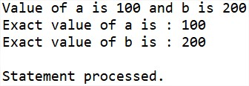
Ex.
DECLARE
a number(3) := 100;
b number(3) := 200;
BEGIN
-- check the boolean condition
IF( a = 100 ) THEN
-- if condition is true then check the following
IF( b = 200 ) THEN
-- if condition is true then print the following
dbms_output.put_line('Value of a is 100 and b is 200' );
END IF;
END IF;
dbms_output.put_line('Exact value of a is : ' || a );
dbms_output.put_line('Exact value of b is : ' || b );
END;
/

Slide 58
Iterative Control & looping structure

Slide 59
Iterative control
Iterative control statement perform one or more statements repeatedly , either a certain number of times or until a condition is meet. There three forms of iterative structures:
1)Basic Loop.
2)While..Loop.
3)For..Loop.

Slide 60
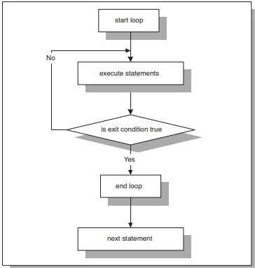
1)Basic Loop.
A basic loop is a loop that is performed repeatedly. once a loop is entered all statement in the loop are performed.
Syntax:
Loop
<statement>
Exit [when <condition>];
Increment statement;
END LOOP

Slide 61
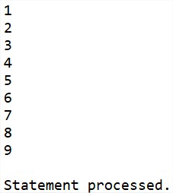
Ex.
declare
i number(3):=1;
begin
loop
exit when(i>=10);
dbms_output.put_line(i);
i:=i+1;
end loop;
end;
/

Slide 62
2)While…Loop.
While loop has a condition associated with the loop.
The condition is evaluated and if the condition is true the statement inside the loop are executed.
Ex.
While<condition>
Loop
<loop body statement>
Increment statement;
End loop

Slide 63
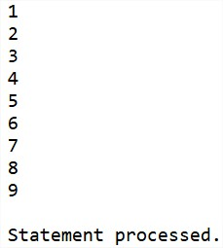
Ex.
declare
i number(3):=1;
begin
while(i<10)
loop
dbms_output.put_line(i);
i:=i+1;
end loop;
end;
/

Slide 64
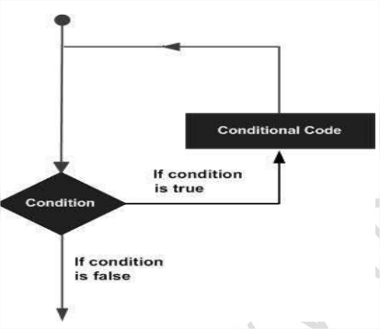
3)For..Loop.
We use FOR..LOOP if we want the iterations to occur a fixed number of times. The FOR..LOOP is executed for a range values.
Syntax:
For<variable>IN <start range>..<end range>
Loop
<loop body statement>
End loop;

Slide 65
Ex…(1)
DECLARE
i number(1);
BEGIN
-- outer_loop
FOR i IN 1..3 LOOP
dbms_output.put_line('i is: '|| i );
END loop ;
END;
/

Slide 66
Ex…(2)
DECLARE
i number(1);
j number(1);
BEGIN
-- outer_loop
FOR i IN 1..3 LOOP
-- inner_loop
FOR j IN 1..3 LOOP
dbms_output.put_line('i is: '|| i || ' and j is: ' || j);
END loop ;
END loop ;
END;
/

Slide 67
EX. (3)
declare
i number(3):=1;
begin
i:=100;
for i in reverse 5..10
loop
dbms_output.put_line(i);
end loop;
end;
/

Slide 68
Sequential Control

Slide 69
Sequential Control GOTO statement
A GOTO statement with a label may be used to pass control to another part of the program.
👉 Note: Using GOTO is not recommended in PL/SQL unless absolutely necessary (it makes the program harder to read and maintain).
Syntax.
GOTO label; ... ... << label >> statement;
label: This is the name of the label to which control will be transferred. Labels are defined within double angle brackets (<< >>).

Slide 70
Ex.
declare
x number(3):=10;
begin
loop
x:=x+3;
if x > 20 then
goto stop;
end if;
end loop;
<<stop>>
dbms_output.put_line('OUTSIDE LOOP...');
end;
/

Slide 71
Execution Flow:
x := 10
Enter the infinite LOOP
Iteration 1 → x = 13 (not > 20, continue loop)
Iteration 2 → x = 16 (not > 20, continue loop)
Iteration 3 → x = 19 (not > 20, continue loop)
Iteration 4 → x = 22 (> 20 → GOTO stop)
Control jumps to the label <<stop>>.
Prints:
OUTSIDE LOOP...
Program ends successfully.

Slide 72
Program in pl/sql

Slide 73
Pro-1 next values generate.
DECLARE
x number := 10;
BEGIN
LOOP
dbms_output.put_line(x);
x := x + 10;
IF x > 50 THEN
exit;
END IF;
END LOOP;
-- after exit, control resumes here
dbms_output.put_line('After Exit x is: ' || x);
END;
/

Slide 74
O /p :
10
20
30
40
50
After Exit x is: 60 Statement processed.

Slide 75
Pro-2 factorial program
declare
i number(4):=1;
n number(4):=5;
f number(4):=1;
begin
for i in 1..n
loop
f:=f*i;
Dbms_output.put_line('The factorial of '||i||' is:'||f);
end loop;
end;
/

Slide 76
Output :
The factorial of 1 is:1
The factorial of 2 is:2
The factorial of 3 is:6
The factorial of 4 is:24
The factorial of 5 is:120
Statement processed.

Slide 77
Pro.-3 Odd even number
Declare
BEGIN
for i in 1..10
loop
if mod(i,2) = 0 then
dbms_output.put_line(i||' is an even number');
else
dbms_output.put_line(i||' is an odd number');
end if;
end loop;
END;
/

Slide 78
1 is an odd number
2 is an even number
3 is an odd number
4 is an even number
5 is an odd number
6 is an even number
………..
…….....
………..
10 is an even number
Statement processed.

Slide 79
Pro-4 block to generate Fibonacci series.
declare
a number:= 0;
b number:= 1;
c number;
begin
dbms_output.put_line(a||' ');
dbms_output.put_line(b||' ');
for i in 3..10
loop
c := a + b;
dbms_output.put_line(c||' ');
a := b;
b := c;
end loop;
end;

Slide 80
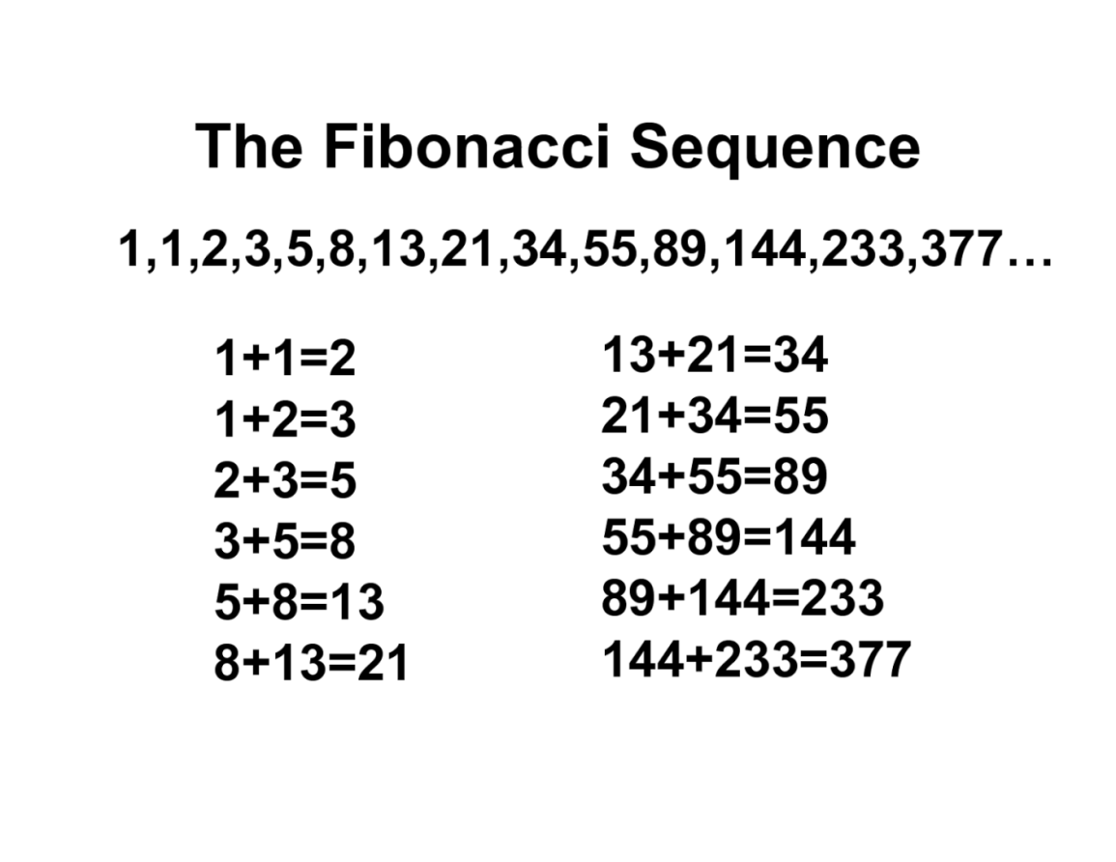
Output:
0 1 1 2 3 5 8 13 21 34
PL/SQL procedure successfully completed

Slide 81
Pro-5 find sum and average of three numbers.
declare
a number:=1;
b number:=2;
c number:=3;
sm number;
av number;
begin
sm:=a+b+c;
av:=sm/3;
dbms_output.put_line('Sum = '||sm);
dbms_output.put_line('Average = '||av);
end;
/

Slide 82
Output :
Sum = 6
Average = 2
PL/SQL procedure successfully completed.

Slide 83
Pro.6 find reverse of a number
declare
N number;
S NUMBER := 0;
R NUMBER;
K number;
begin
N := 1234;
K := N;
loop
exit WHEN N = 0;
S := S * 10;
R := MOD(N,10);
S := S + R;
N := TRUNC(N/10);
end loop;
dbms_output.put_line('THE REVERSED DIGITS OF '||K||' = '||S);
End;

Slide 84
Output :
THE REVERSED DIGITS OF 1234 = 4321
Statement processed.

Slide 85
Ex.2 REVERSED number
declare
i number(3);
begin
dbms_output.put_line('THE REVERSED DIGITS OF 5 6 7 8 9 10 is ');
for i in reverse 5..10
loop
dbms_output.put_line(i);
end loop;
end;
/

Slide 86
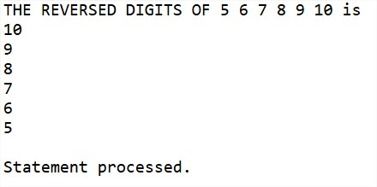

Slide 87
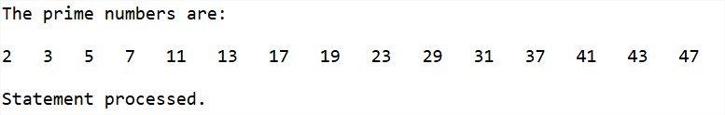
Prime number
DECLARE
i NUMBER(3);
j NUMBER(3);
BEGIN
dbms_output.Put_line('The prime numbers are:');
dbms_output.new_line;
i := 2;
LOOP
j := 2;
LOOP
EXIT WHEN( ( MOD(i, j) = 0 )
OR ( j = i ) );
j := j + 1;
END LOOP;
IF( j = i )THEN
dbms_output.Put(i||' ');
END IF;
i := i + 1;
exit WHEN i = 50;
END LOOP;
dbms_output.new_line;
END;
/

Slide 88
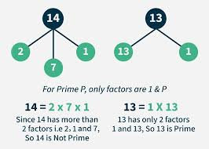
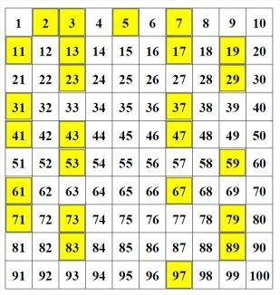
Prime number

Slide 89
Armstrong number
declare
n number:=407;
s number:=0;
r number;
len number;
m number;
begin
m:=n;
len:=length(to_char(n));
while n>0
loop
r:=mod(n,10);
s:=s+power(r,len);
n:=trunc(n/10);
end loop;
if m=s
then
dbms_output.put_line('armstrong number');
else
dbms_output.put_line('not armstrong number');
end if;
end;

Slide 90
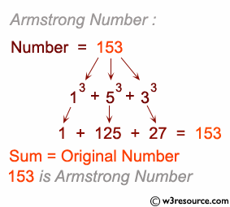
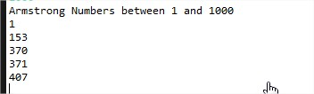
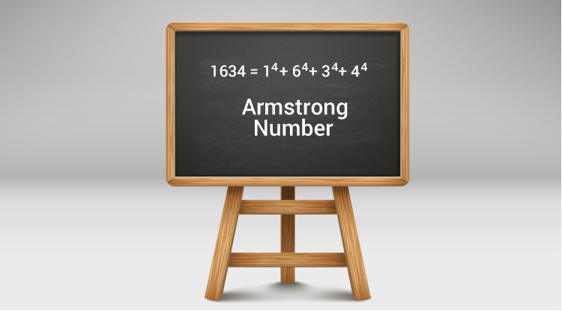
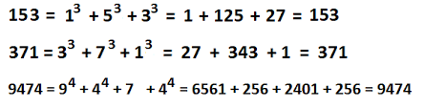
Armstrong number

Slide 91
Palindrome Number in PL/SQL
declare
num number := 12321; -- Change this to test
temp number;
rev number := 0;
digit number;
begin
temp := num;
while temp > 0 loop
digit := mod(temp, 10); -- get last digit
rev := (rev * 10) + digit; -- build reverse number
temp := trunc(temp / 10); -- remove last digit
end loop;
if rev = num then
dbms_output.put_line(num || ' is a Palindrome Number');
else
dbms_output.put_line(num || ' is Not a Palindrome Number');
end if;
end;
/

Slide 92
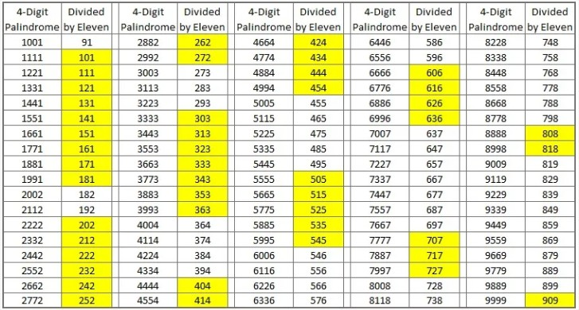
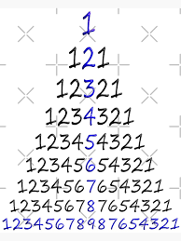
1234321 is a Palindrome Number
Statement processed.

Slide 93
Reverse a String in PL/SQL
DECLARE
original_str VARCHAR2(100) := 'Hello, World!';
reversed_str VARCHAR2(100) := '';
BEGIN
FOR i IN REVERSE 1 .. LENGTH(original_str) LOOP
reversed_str := (reversed_str || SUBSTR(original_str, i, 1));
DBMS_OUTPUT.PUT_LINE('Reversed String: ' || reversed_str);
END LOOP;
DBMS_OUTPUT.PUT_LINE('Original String: ' || original_str);
DBMS_OUTPUT.PUT_LINE('Reversed String: ' || reversed_str);
END;
/

Slide 94
📝 Explanation:
original_str is the string you want to reverse.
FOR i IN REVERSE loops backward from the end of the string.
SUBSTR(original_str, i, 1) gets each character from the end.
DBMS_OUTPUT.PUT_LINE prints the result.
Output :
Original String: Hello, World!
Reversed String: !dlroW ,olleH.
Statement processed.

Slide 95
Write a PL/SQL program to find the sum of digits of a given number.
DECLARE
v_num NUMBER := 9875; -- Input number
v_sum NUMBER := 0; -- To store sum of digits
v_rem NUMBER; -- To hold remainder (digit)
BEGIN
WHILE v_num > 0 LOOP
v_rem := MOD(v_num, 10); -- Get last digit
v_sum := v_sum + v_rem; -- Add to sum
v_num := TRUNC(v_num / 10); -- Remove last digit
END LOOP;
DBMS_OUTPUT.PUT_LINE('Sum of digits = ' || v_sum);
END;
/

Slide 96
For 9875 → 9 + 8 + 7 + 5 = 29
Sum of digits = 29

Slide 97
Advanced PL/SQL

Slide 98
PL/SQL– Arrays

Slide 99
PL/SQL– VArrays
The PL/SQL programming language provides a data structure called the VARRAY.
which can store a fixed-size sequential collection of elements of the same type.
A varray is used to store an ordered collection of data, however it is often better to think of an array as a collection of variables of the same type.
All varrays consist of contiguous memory locations.

Slide 100
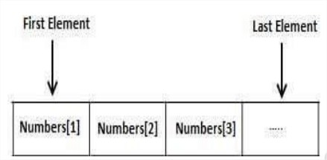
The lowest address corresponds to the first element and the highest address to the last element.

Slide 101
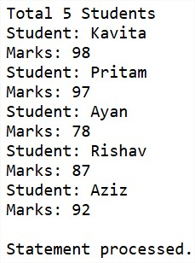
Ex.
DECLARE
type namesarray IS VARRAY(5) OF VARCHAR2(10);
type grades IS VARRAY(5) OF INTEGER;
names namesarray;
marks grades;
total integer;
BEGIN
names := namesarray('Kavita', 'Pritam', 'Ayan', 'Rishav', 'Aziz');
marks:= grades(98, 97, 78, 87, 92);
total := names.count;
dbms_output.put_line('Total '|| total || ' Students');
FOR i in 1 .. total LOOP
dbms_output.put_line('Student: ' || names(i) || '
Marks: ' || marks(i));
END LOOP;
END;

Slide 102
% TYPE and % ROWTYPE

Slide 103
% TYPE
→ Used to declare a variable with the same data type as a table column or another variable.
→ %TYPE is used to declare a field with the same type as that of a specified table's column:
→This is particularly useful when you want to ensure that your variable matches the column's data type.
Syntax:
variable_name table_name.column_name%TYPE;

Slide 104
Ex. 1 Multiple variables with %TYPE
declare
no emp.id %type;
nm emp.name %type;
sal emp.salary %type;
begin
select id,name,salary into no,nm,sal from emp WHERE ROWNUM = 1;
dbms_output.put_line(no);
dbms_output.put_line(nm);
dbms_output.put_line(sal);
end;
/

Slide 105
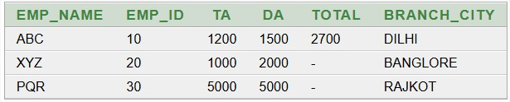
Ex. 2
create table type (emp_name varchar(10),emp_id number(10),TA number(10),DA number(10),total number(10),branch_city varchar(10))
insert into type values('ABC',10,1200,1500,2700,'DILHI');
insert into type values('XYZ',20,1000,2000,NULL,'BANGLORE');
insert into type values('PQR',30,5000,5000,NULL,'RAJKOT');
select *from type

Slide 106
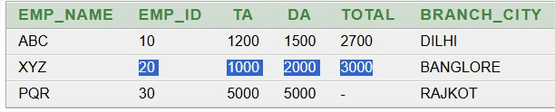
Ex. 2 conti….. %type
declare
a type.TA %type;
b type.DA %type;
t type.total %type;
begin
select TA,DA into a,b from type where emp_id=20;
t:= a+b;
update type set total=t where emp_id=20;
end;

Slide 107
Ex.3 Variable based on another variable
DECLARE
v_base_salary NUMBER(8,2);
v_bonus v_base_salary%TYPE; -- same type as v_base_salary
BEGIN
v_base_salary := 50000;
v_bonus := 5000;
DBMS_OUTPUT.PUT_LINE('Salary: ' || v_base_salary || ' Bonus: ' || v_bonus);
END;

Slide 108
Ex 4: Insert using %TYPE
DECLARE
v_nm type.emp_name%TYPE := 'red';
v_id type.emp_id%TYPE := '40';
v_salary type.total%TYPE := 60000;
BEGIN
INSERT INTO type(emp_name, emp_id, total)
VALUES (v_nm, v_id, v_salary);
DBMS_OUTPUT.PUT_LINE('Record Inserted!');
END;

Slide 109
%ROWTYPE

Slide 110
%ROWTYPE
→%ROWTYPE has all properties of %TYPE and one additional what we required only one variable to access any number of columns.
→ %ROWTYPE is used to declare a record with the same types as found in the specified database table, view or cursor:
→This is useful when you want to work with multiple columns from a table without declaring each column individually.
Syntax:
variable_name table_name%ROWTYPE;

Slide 111
Ex.1 Simple %ROWTYPE with table
declare
my emp %rowtype;
begin
select * into my from emp WHERE ROWNUM = 1;
dbms_output.put_line('id is:'||my.id);
dbms_output.put_line('name is:'||my.name);
dbms_output.put_line('salary is:'||my.salary);
end;
/

Slide 112
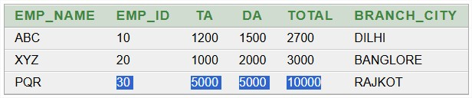
Ex.2 %rowtype
declare
record type%ROWTYPE;
begin
select * into record from type where emp_id=30;
record.total:=record.TA + record.DA;
update type set total=record.total where emp_id=30;
end;

Slide 113
Ex 3: Copying One Row to Another
DECLARE
v_emp1 emp%ROWTYPE;
v_emp2 emp%ROWTYPE;
BEGIN
SELECT * INTO v_emp1 FROM emp WHERE id = 4;
v_emp2 := v_emp1; -- copy entire row
DBMS_OUTPUT.PUT_LINE('Copied Employee: ' || v_emp2.name);
END;
/

Slide 114
Cursor

Slide 115
Using Cursor (Implicit, Explicit)

Slide 116
What is cursor ?
The oracle engine uses a work area for its internal processing in order to execute an SQL statement. This work area is call CURSOR.
The cursor is used to retrieve data one row at a time from the results set .
A cursor, either explicit or implicit, is used to handle the result set of a SELECT statement.
The data stored in the cursor memory is call the ‘ACTIVE DATA SET’.

Slide 117
Types of cursor
(1)implicit cursor (SQL cursor :open and managed by oracle)
(2)Explicit cursor (user defined cursor : open and managed by user)

Slide 118
(1)implicit cursor
It is a SQL cursor :open and managed by oracle engine internally.
Implicit cursor using SELECT statement returning one row of data.
The SQL cursor/implicit cursor four attributes:
SQL%found
SQL%notfound
SQL%rowcount
SQL%ISOPEN

Slide 119
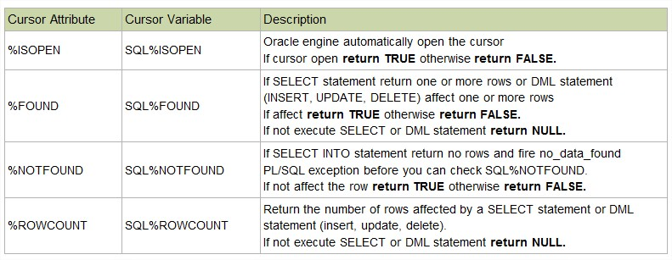

Slide 120
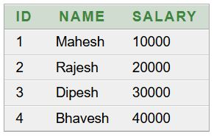
Create table emp (id number(3),name char(20),salary number(10))
insert into emp values(1,'Mahesh',10000)
insert into emp values(2,'Rajesh',20000)
insert into emp values(3,'Dipesh',30000)
insert into emp values(4,'Bhavesh',40000)
select *from emp

Slide 121
Ex.1 SELECT INTO (Implicit Cursor) %FOUND
DECLARE
v_name emp.name%TYPE;
BEGIN
-- Implicit cursor created automatically
SELECT name INTO v_name FROM emp WHERE id = 1;
DBMS_OUTPUT.PUT_LINE('Employee Name: ' || v_name);
-- Cursor attributes
IF SQL%FOUND THEN
DBMS_OUTPUT.PUT_LINE('Row found.');
END IF;
END;
/

Slide 122
Ex.2 UPDATE with Implicit Cursor(%FOUND ,%NOTFOUND)
--Write a PL/SQL block to display message that whether a record is updated or not.
Declare
begin
update emp set name='Rakesh' where id=4;
if SQL%FOUND then
dbms_output.put_line('record updated');
end if;
if SQL%NOTFOUND then
dbms_output.put_line('record not updated');
end if;
end;

Slide 123
Ex.3 %ROWCOUNT
declare
num number(2);
begin
update emp set salary=1500 where salary>15000;
num:=SQL%ROWCOUNT;
dbms_output.put_line('total rows affected =' ||num);
end;

Slide 124
ex.4 sql%rowcount
DECLARE
total_rows number(2);
BEGIN
UPDATE emp SET salary = salary + 500;
IF sql%notfound THEN
dbms_output.put_line('no employee selected');
ELSIF sql%found THEN
total_rows := sql%rowcount;
dbms_output.put_line( total_rows || ' employee selected ');
END IF;
END;
/

Slide 125
(2)Explicit cursor
🔹 What is an Explicit Cursor?
A cursor is like a pointer that helps you fetch rows one by one from a query result.
In explicit cursor, you manually declare, open, fetch, and close the cursor.
Useful when query returns multiple rows.
Four action can be perform on explicit cursor:
Declare the cursor
Open the cursor
Fetch the data from cursor
Close the cursor

Slide 126
Example (Explicit cursor)
declare
e_nm emp.name%type;
e_sl emp.salary%type;
cursor c1 is select name,salary from emp;
begin
open c1;
fetch c1 into e_nm,e_sl;
dbms_output.put_line('salary of '|| e_nm ||' is '||e_sl);
fetch c1 into e_nm,e_sl;
dbms_output.put_line('salary of '|| e_nm ||' is '||e_sl);
fetch c1 into e_nm,e_sl;
dbms_output.put_line('salary of '|| e_nm ||' is '||e_sl);
end;
O/p: salary of aaa is 3000
salary of bbb is 2000
salary of bbb is 5000
is Statement processed.

Slide 127
Example Program.
-- Suppose we have an EMP table with columns ID, NAME, SALARY
DECLARE
CURSOR emp_cur IS
SELECT id, name, salary FROM emp;
v_id emp.id%TYPE;
v_name emp.name%TYPE;
v_salary emp.salary%TYPE;
BEGIN
OPEN emp_cur;
LOOP
FETCH emp_cur INTO v_id, v_name, v_salary;
EXIT WHEN emp_cur%NOTFOUND;
DBMS_OUTPUT.PUT_LINE('ID: ' || v_id ||
', Name: ' || v_name ||
', Salary: ' || v_salary);
END LOOP;
CLOSE emp_cur;
END;

Slide 128
🔹 Fill in the Blanks
A __________ is a pointer to the result set of a SQL query. Answer: Cursor
__________ cursors are automatically created by Oracle for DML statements. Answer: Implicit
__________ cursors are created explicitly by the programmer. Answer: Explicit
The attributes %FOUND, %NOTFOUND, %ROWCOUNT, and %ISOPEN are used with __________. Answer: Cursors
In explicit cursors, after fetching rows, we must use the __________ statement to release memory. Answer: CLOSE
In implicit cursors, Oracle automatically handles __________, __________, and __________ operations. Answer: Open, Fetch, Close
The cursor attribute that gives the total number of rows fetched is __________. Answer: %ROWCOUNT

Slide 129
🔹 True / False
Implicit cursors are created automatically by Oracle for SELECT INTO statements. Answer: True
Explicit cursors require manual OPEN, FETCH, and CLOSE. Answer: True
%ISOPEN is always TRUE for implicit cursors. Answer: False (implicit cursors are closed automatically)
%NOTFOUND returns TRUE when no more rows are available. Answer: True
Cursors can only be used with SELECT statements. Answer: False (also used with INSERT, UPDATE, DELETE for row count checking)

Slide 130
Exception Handling

Slide 131
Exception handling in pl/sql
An exception is an error condition during a program execution.
PL/SQL supports programmers to catch such conditions using EXCEPTION block in the program and an appropriate action is taken against the error condition.
There are two types of exceptions
System-defined exceptions
User-defined exceptions

Slide 132
syntax
DECLARE
-- Declarations (variables, constants, cursors, etc.)
BEGIN
-- Executable statements
EXCEPTION
-- Exception handling section
WHEN exception_name THEN
-- Statements to handle the error
WHEN OTHERS THEN
-- Handle all other exceptions
END;
/

Slide 133
🔹 Types of Exceptions in PL/SQL
PL/SQL provides two categories of exceptions:
1. Predefined Exceptions
Oracle provides many built-in exceptions.
Example:
NO_DATA_FOUND,
ZERO_DIVIDE,
TOO_MANY_ROWS,
INVALID_NUMBER, etc.
These are automatically raised by Oracle.
2. User-Defined Exceptions
Developers can define their own exceptions and raise them using RAISE.

Slide 134
🔹 Ex.1 NO_DATA_FOUND
DECLARE
v_name emp.name %type;
BEGIN
select name into v_name from emp where id=10;
dbms_output.put_line(v_name);
EXCEPTION
when NO_DATA_FOUND then
dbms_output.put_line('Data not found');
when OTHERS then
dbms_output.put_line('Error occur');
END;
✅ Output: Error: Data not found .

Slide 135
🔹 Ex.2 Predefined Exception (ZERO_DIVIDE)
DECLARE
v_result NUMBER;
BEGIN
v_result := 10 / 0; -- Will cause ZERO_DIVIDE exception
DBMS_OUTPUT.PUT_LINE('Result: ' || v_result);
EXCEPTION
WHEN ZERO_DIVIDE THEN
DBMS_OUTPUT.PUT_LINE('Error: Division by zero is not allowed.');
END;
/
✅ Output: Error: Division by zero is not allowed.

Slide 136
🔹 Ex.3 Predefined Exception (OO_MANY_ROWS)
-- Example: TOO_MANY_ROWS Exception
DECLARE
v_name emp.name%TYPE; -- Variable to hold employee name
BEGIN
-- This query will return more than one row if id = 10 has multiple employees
SELECT name INTO v_name FROM emp WHERE id = 10;
DBMS_OUTPUT.PUT_LINE('Employee Name: ' || v_name);
EXCEPTION
WHEN TOO_MANY_ROWS THEN
DBMS_OUTPUT.PUT_LINE('Error: More than one employee found for id10.');
WHEN OTHERS THEN
DBMS_OUTPUT.PUT_LINE('Some other error occurred: ' || SQLERRM);
END;
✅ Output: Some other error occurred: ORA-01403: no data found

Slide 137
🔹 User-Defined Exception Example
DECLARE
insufficient_balance EXCEPTION;
v_balance NUMBER := 500;
v_withdraw NUMBER := 1000;
BEGIN
IF v_withdraw > v_balance THEN
RAISE insufficient_balance; -- Raise user-defined exception
ELSE
v_balance := v_balance - v_withdraw;
END IF;
DBMS_OUTPUT.PUT_LINE('Remaining Balance: ' || v_balance);
EXCEPTION
WHEN insufficient_balance THEN
DBMS_OUTPUT.PUT_LINE('Error: Withdrawal amount exceeds balance.');
END;
/
✅ Output: Error: Withdrawal amount exceeds balance.

Slide 138
EX. EXCEPTION HANDLING
declare
e_name emp.name%type;
e_salary emp.salary%type;
begin
select name into e_name from emp;
exception
when no_data_found then
dbms_output.put_line('record does not exits');
when too_many_rows then
dbms_output.put_line('multiple rows retrieved');
when others then
dbms_output.put_line('errors in retrieval');
end;

Slide 140
Advanced PL/SQL

Slide 141
Advanced PL/SQL
'PL/SQL - Packages'.
PL/SQL subprograms are named PL/SQL blocks that can be invoked with a set of parameters. PL/SQL provides two kinds of subprograms −
Functions − These subprograms return a single value; mainly used to compute and return a value.
Procedures − These subprograms do not return a value directly; mainly used to perform an action.

Slide 142
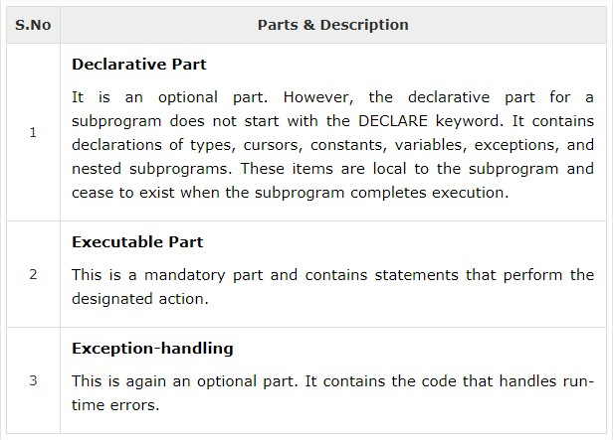
Parts of a PL/SQL Subprogram

Slide 143
Creating a Procedure
A procedure is created with the CREATE OR REPLACE PROCEDURE statement. The simplified syntax for the CREATE OR REPLACE PROCEDURE statement is as follows −
CREATE [OR REPLACE] PROCEDURE procedure_name
[(parameter_name [IN | OUT | IN OUT] type [, ...])]
{IS | AS}
BEGIN
< procedure_body >
END procedure_name; ;

Slide 144
Where,
procedure-name specifies the name of the procedure.
[OR REPLACE] option allows the modification of an existing procedure.
The optional parameter list contains name, mode and types of the parameters. IN represents the value that will be passed from outside and OUT represents the parameter that will be used to return a value outside of the procedure.
procedure-body contains the executable part.
The AS keyword is used instead of the IS keyword for creating a standalone procedure.

Slide 145
Example
CREATE OR REPLACE PROCEDURE greetings
AS
BEGIN
dbms_output.put_line('Hello World!');
END;
Executing a called from another PL/SQL block
BEGIN
greetings;
END;
O/p:
Hello World
PL/SQL procedure successfully completed.

Slide 146
Deleting a Standalone Procedure
A standalone procedure is deleted with the DROP PROCEDURE statement. Syntax for deleting a procedure is −
DROP PROCEDURE procedure-name;

Slide 147
Parameter Modes in PL/SQL Subprograms
[1] IN:
An IN parameter lets you pass a value to the subprogram.
It is a read-only parameter.
Inside the subprogram, an IN parameter acts like a constant.
It cannot be assigned a value.
You can pass a constant, literal, initialized variable, or expression as an IN parameter.
You can also initialize it to a default value; however, in that case, it is omitted from the subprogram call.
It is the default mode of parameter passing.
Parameters are passed by reference.

Slide 148
OUT
An OUT parameter returns a value to the calling program.
Inside the subprogram, an OUT parameter acts like a variable.
You can change its value and reference the value after assigning it.
The actual parameter must be variable and it is passed by value.

Slide 149
IN OUT
An IN OUT parameter passes an initial value to a subprogram and returns an updated value to the caller.
It can be assigned a value and the value can be read.
The actual parameter corresponding to an IN OUT formal parameter must be a variable, not a constant or an expression.
Formal parameter must be assigned a value.
Actual parameter is passed by value.

Slide 150
IN & OUT Mode Example 1
This program finds the minimum of two values. Here, the procedure takes two numbers using the IN mode and returns their minimum using the OUT parameters.

Slide 151
DECLARE
a number;
b number;
c number;
PROCEDURE findMin(x IN number, y IN number, z OUT number) IS
BEGIN
IF x < y THEN
z:= x;
ELSE
z:= y;
END IF;
END;
BEGIN
a:= 23;
b:= 45;
findMin(a, b, c);
dbms_output.put_line(' Minimum of (23, 45) : ' || c);
END;

Slide 152
IN & OUT Mode Example 2
This procedure computes the square of value of a passed value. This example shows how we can use the same parameter to accept a value and then return another result.

Slide 153
DECLARE
a number;
PROCEDURE squareNum(x IN OUT number) IS
BEGIN
x := x * x;
END;
BEGIN
a:= 23;
squareNum(a);
dbms_output.put_line(' Square of (23): ' || a);
END;

Slide 154
Methods for Passing Parameters
Actual parameters can be passed in three ways −
Positional notation
Named notation
Mixed notation

